Slide 1
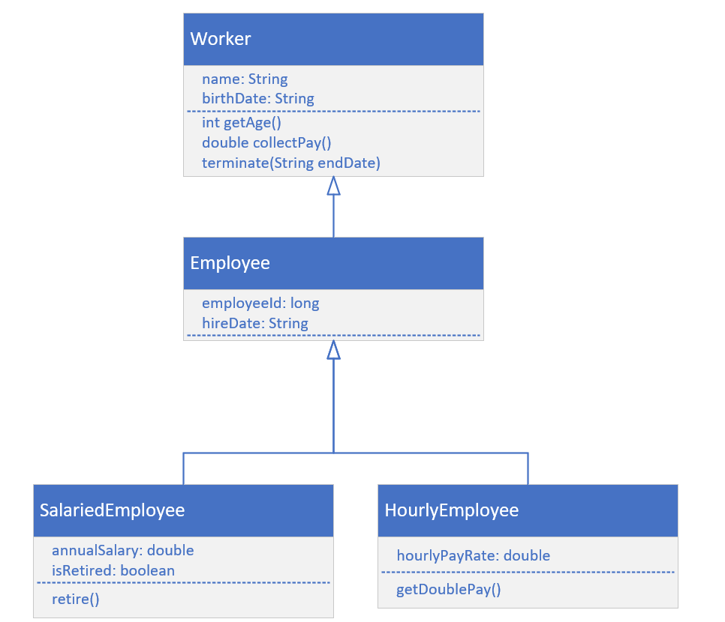

Inheritance Challenge, Continued
It's time to build a more specific type of Employee, one that's Salaried, or one that's Hourly.
A salaried employee, is paid based on some percentage of his or her salary.
It this person is retired, then the salary may be 100 percent, but it is generally reduced somewhat.
An hourly employee, is paid by the hours worked, and the hourly rate they agreed to work for.
An hourly employee may also get double pay, if they work over a certain amount of hours.
COMPLETE JAVA MASTERCLASS
Inheritance Challenge Part 2

Slide 2
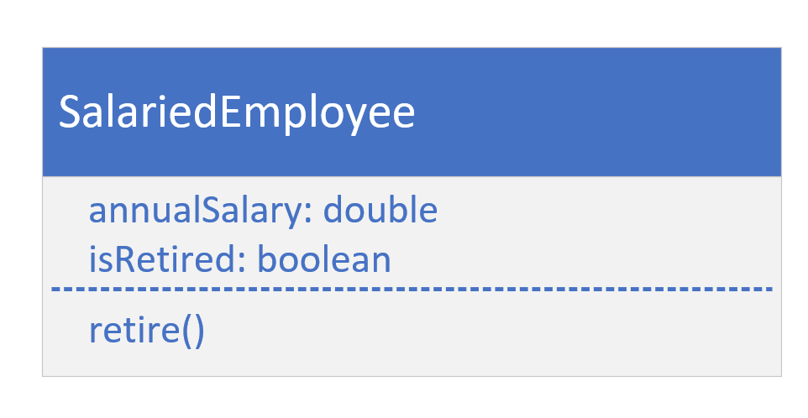
SalariedEmployee
COMPLETE JAVA MASTERCLASS
Inheritance Challenge Part 2

Slide 3
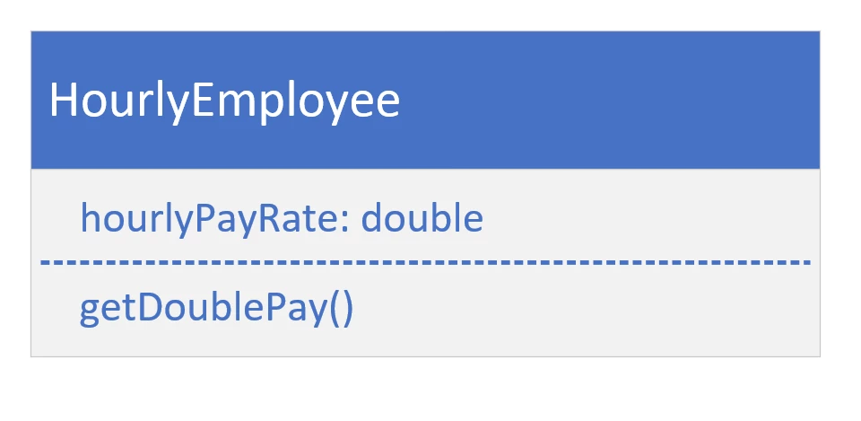
HourlyEmployee class
COMPLETE JAVA MASTERCLASS
Inheritance Challenge Part 2

Slide 4
Making the call
Each method call, made on these objects, points to the code that will actually be executed.
When joe or mary call getAge(), the method's implementation is on Worker, and not overridden by any other class, so the getAge method on Worker is executed.
Joe
A SalariedEmployee
Mary
An HourlyEmployee
Object
toString()
Worker
getAge
collectPay
@Override toString()
getAge()
getAge()
toString()
Employee
@Override toString()
getJobReview
toString()
collectPay()
collectPay()
SalariedEmployee
@Override collectPay
retire
HourlyEmployee
@Override collectPay
getDoublePay()
retire()
getDoubePay()
COMPLETE JAVA MASTERCLASS
Inheritance Challenge Part 2

Slide 5
Making the call
When joe or mary call toString(), this method has been overridden twice, first by Worker, and then by Employee. But it wasn't overridden by either SalariedEmployee, or HourlyEmployee, so the method from the Employee class is the one that's used.
Joe
A SalariedEmployee
Mary
An HourlyEmployee
Object
toString()
Worker
getAge
collectPay
@Override toString()
getAge()
getAge()
toString()
Employee
@Override toString()
getJobReview
toString()
collectPay()
collectPay()
SalariedEmployee
@Override collectPay
retire
HourlyEmployee
@Override collectPay
getDoublePay()
retire()
getDoubePay()
COMPLETE JAVA MASTERCLASS
Inheritance Challenge Part 2

Slide 6
Making the call
Looking at the collectPay method, this method was overridden by both SalariedEmployee, and HourlyEmployee.
Joe will execute the method on SalariedEmployee.
Mary will execute the one on HourlyEmployee.
Joe
A SalariedEmployee
Mary
An HourlyEmployee
Object
toString()
Worker
getAge
collectPay
@Override toString()
getAge()
getAge()
toString()
Employee
@Override toString()
getJobReview
toString()
collectPay()
collectPay()
SalariedEmployee
@Override collectPay
retire
HourlyEmployee
@Override collectPay
getDoublePay()
retire()
getDoubePay()
COMPLETE JAVA MASTERCLASS
Inheritance Challenge Part 2

Slide 7
Making the call
SalariedEmployee has a method, retire, that's not overridden, meaning it's only on that class, it's a method specific to a Salaried employee.
HourlyEmployee has its own method, getDoublePay, which wouldn't apply to a Salaried employee, so we declared it on this class, and not in any super class.
Joe
A SalariedEmployee
Mary
An HourlyEmployee
Object
toString()
Worker
getAge
collectPay
@Override toString()
getAge()
getAge()
toString()
Employee
@Override toString()
getJobReview
toString()
collectPay()
collectPay()
SalariedEmployee
@Override collectPay
retire
HourlyEmployee
@Override collectPay
getDoublePay()
retire()
getDoubePay()
COMPLETE JAVA MASTERCLASS
Inheritance Challenge Part 2

